Slide 1
BIA 678 Big Data Seminar
Credit Card Fraud Detection
Instructor: Dr. David Belanger
Group 7: Raj Mehta
Smriti Vimal
Taranpreet Singh

Slide 2

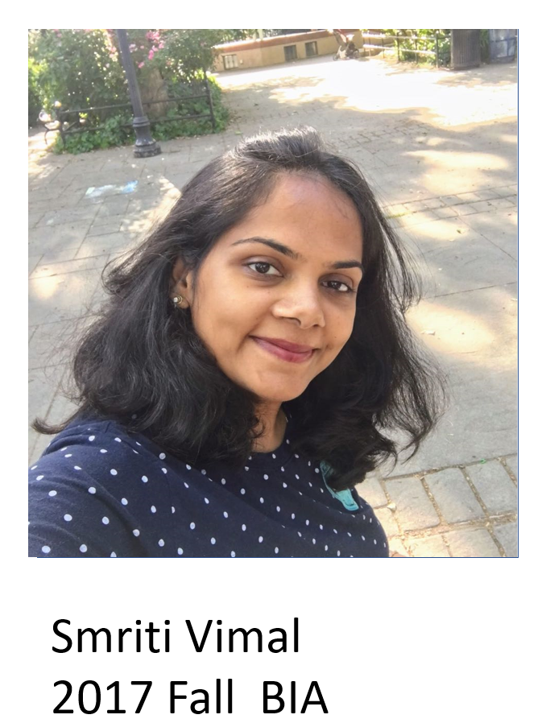
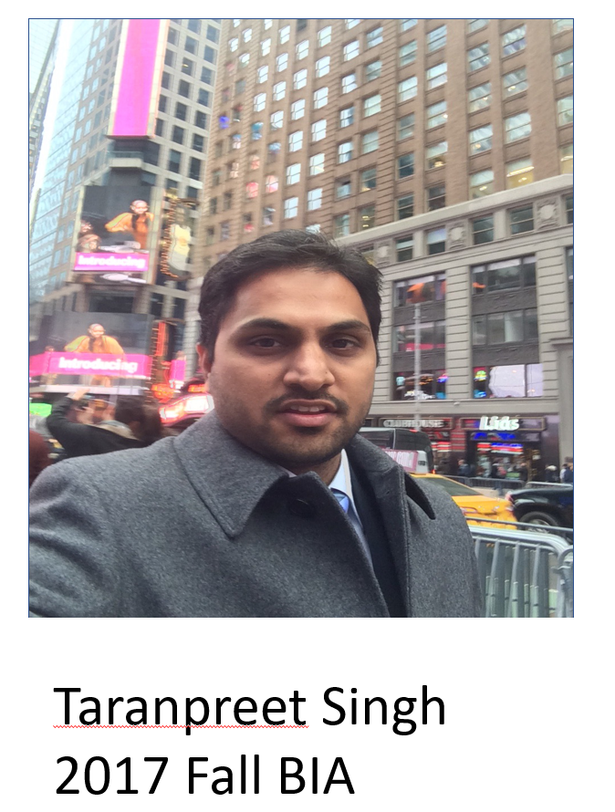
Members

Slide 3
Content
Introduction
Flow Chart
Data Collection
Model
Evaluation
Conclusion
Future Work
Demo

Slide 4
Introduction
Background
Digital Currency is ever –growing.
Although very helpful and convenient – there are challenges – FRAUDS!!
Numbers say it all!
46% of Americans have fallen victim to credit card fraud in the past five years
Losses from credit card fraud exceeded $24 billion in 2016

Slide 5
Objective
Determine whether a transaction done is Fraud or not
Evaluate the performance of the following classification algorithms on local machine and Spark cluster:
Logistic Regression
Decision Tree
Random Forest
Gradient Boost

Slide 6
Spark
Apache Spark is an open source data processing framework for performing Big data analytics on distributed computing cluster.
The core data structure in Spark is RDD (Resilient Distributed Dataset). RDD is Spark's representation of a dataset that is distributed across the RAM.
Spark provides APIs in Scala, Java, Python, and R – We use PySpark
Spark Run programs up to 100x faster than Hadoop MapReduce in memory, or 10x faster on disk.

Slide 7
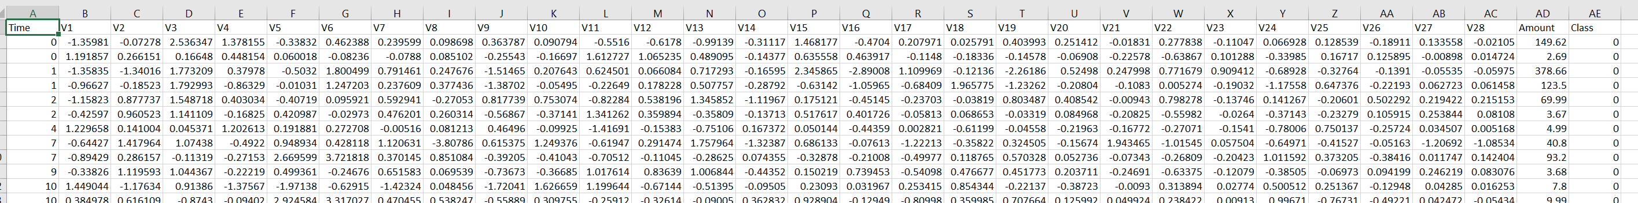
Data Set
Source: www.Kaggle.com
Dataset contains transactions made by credit cards in two days in September 2013 by European cardholders
492 frauds out of 284,807 transactions
Highly unbalanced, the positive class (frauds) account for 0.172% of all transactions
Contains only numerical input variables which are the result of a PCA transformation.

Slide 8
Model on Different Platform
Calculated by Spark
Calculated by local machine

Slide 9
Result

Slide 10
Evaluation
Size: 10, 100, 1000, 10000, 50000, 100000, 469156
For each point, repeat 3 times and calculate the average running time

Slide 11
Conclusions

Slide 12
Future work

Slide 13
Demo

